Slide 1

Homework 6
Ding Jieqiong
https://github.com/Aprillll-7/Creative-Computing-2023-FALL/tree/main

Slide 2
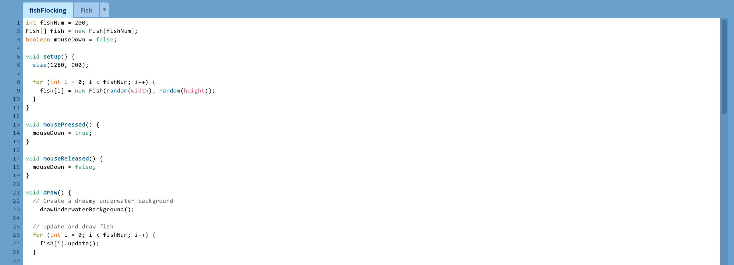
Code

Slide 3
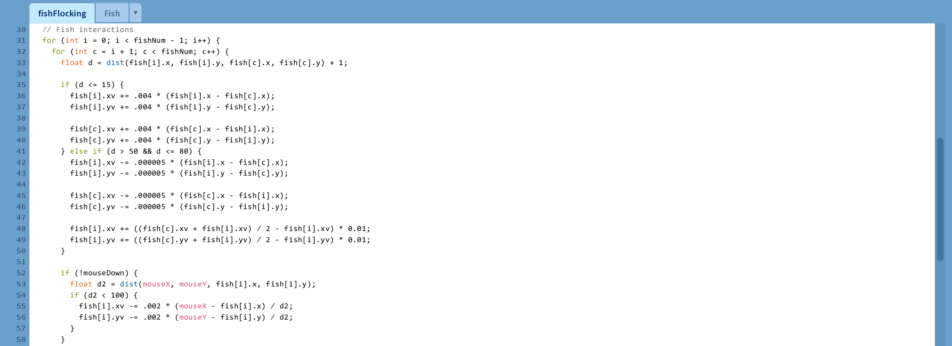
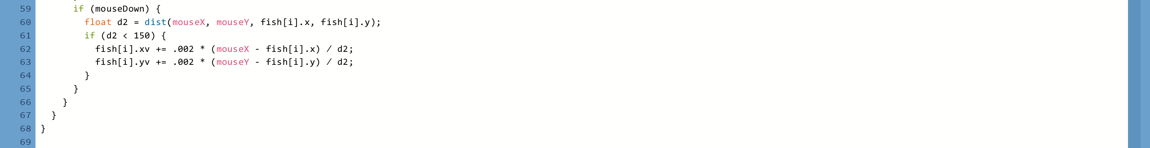
Code

Slide 4
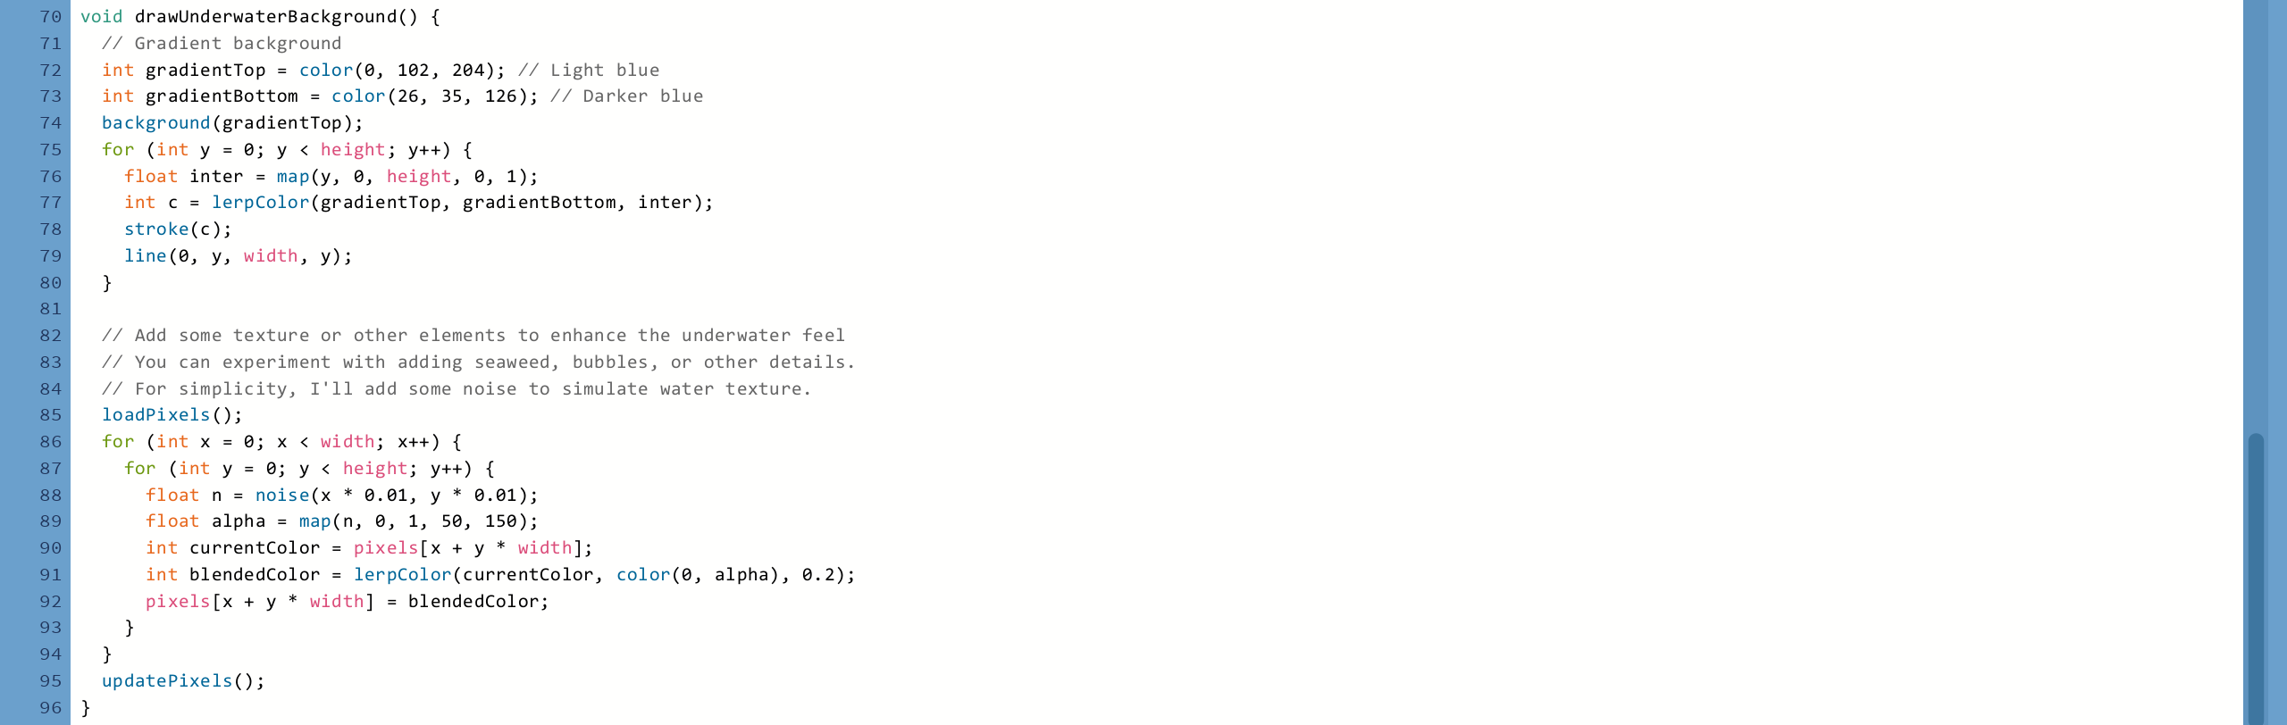
Code

Slide 5
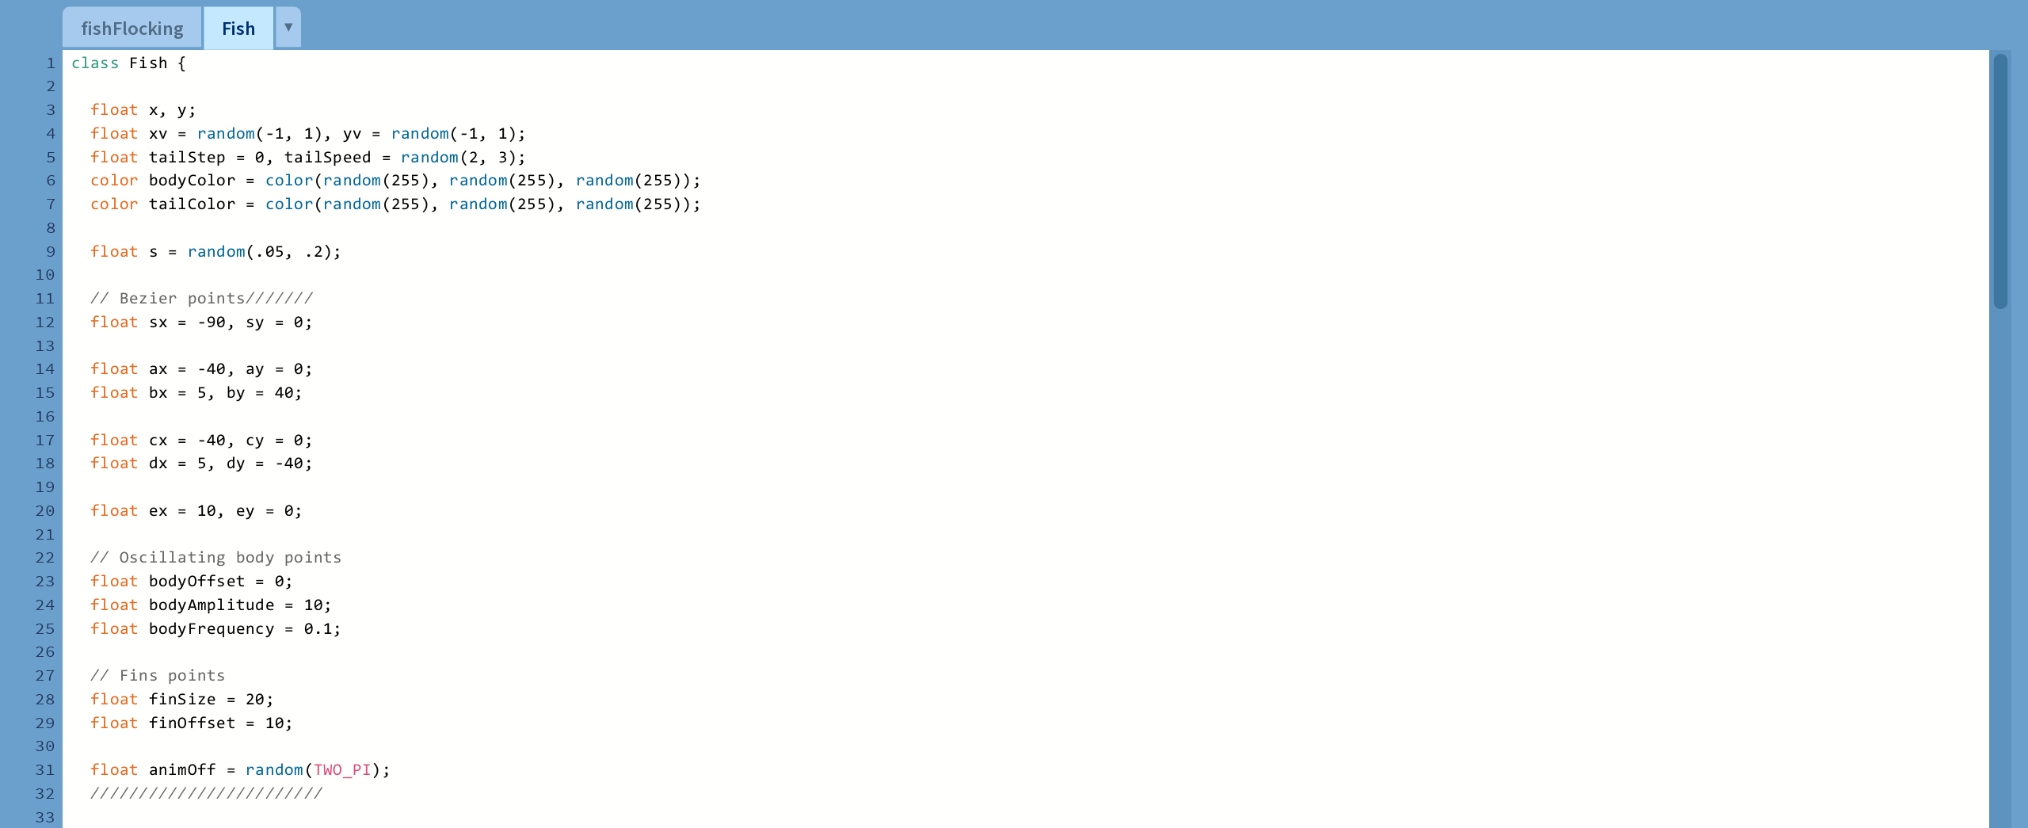
Code

Slide 6
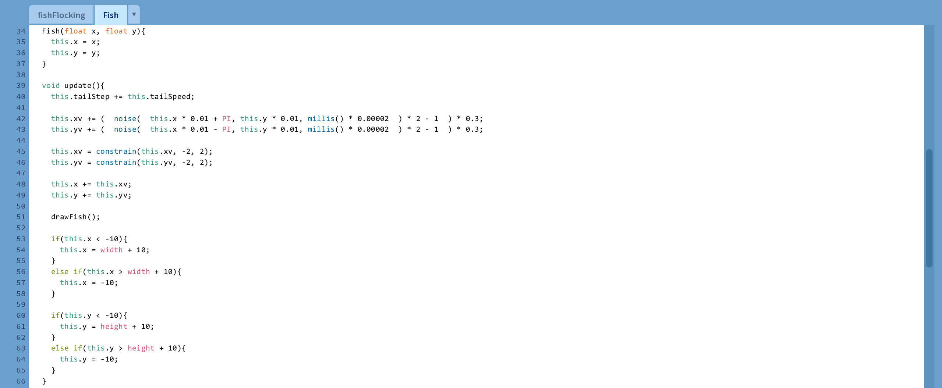
Code

Slide 7
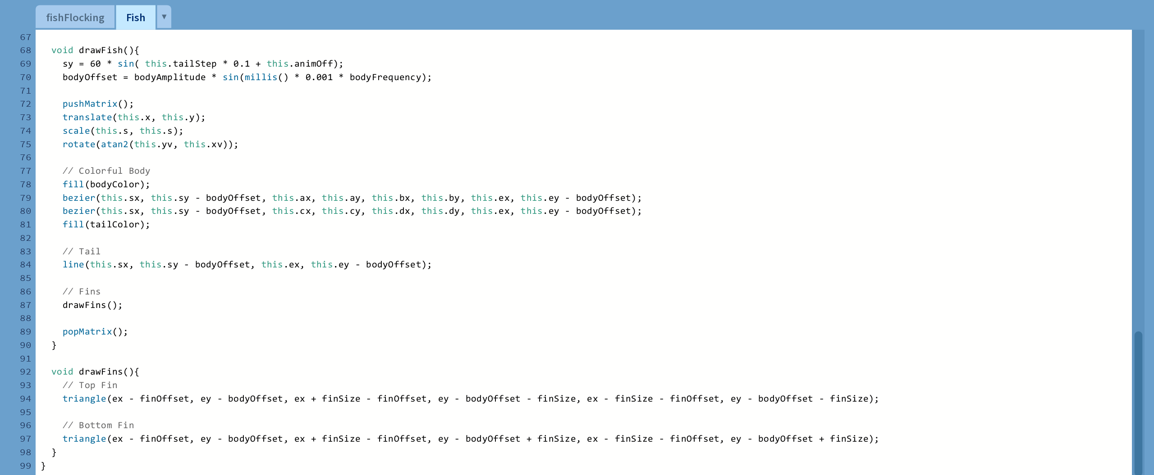
Code

Slide 8


